Slide 1
Lecture 1
Interaction of OS and hardware, Goals of OS, Basic functions of OS, OS Services, System Calls, Types of system calls.

Slide 2
OS definition
Operating System (OS) is system software, which acts as an interface between a user of the computer and the computer hardware. It is a supervisory program that manages hardware, processes, files, memory, I/O etc. in the system. It acts as a resource manager and
The main purpose of an Operating System is:
to provide an environment in which we can execute programs.
The main goals of the Operating System are:
To make the computer system convenient to use,
To make the use of computer hardware in efficient way.

Slide 3
Interaction of OS and hardware
Scene 1: Perform basic tasks such as recognizing input from the keyboard, sending output to the display screen, keeping track of files and directories on the disk, and controlling peripheral devices such as disk drives and printers – OS addresses the need for managing the computer hardware
Scene 2: Provide a software platform on top of which other programs can run- OS provides an interface between application software and hardware

Slide 4
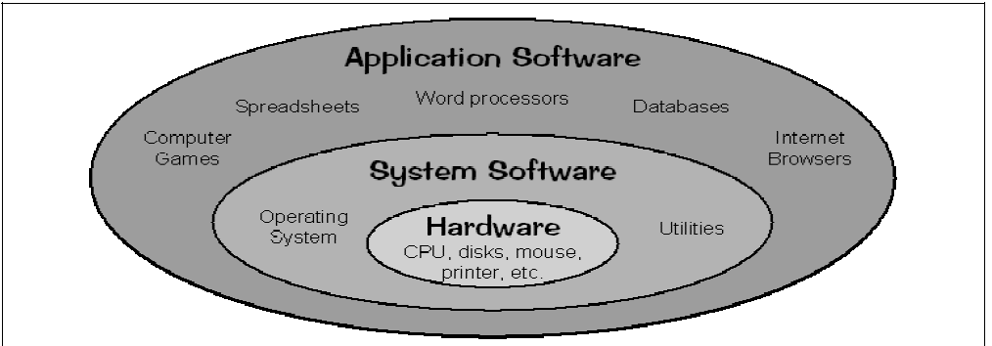

Slide 5
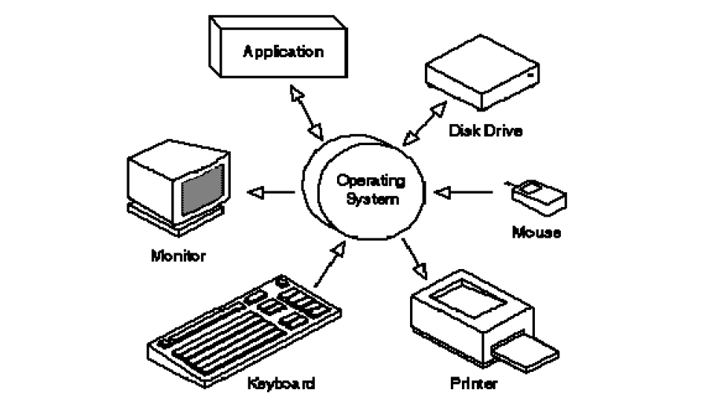
As a user, we normally interact with the Operating System through a set of commands. The commands are accepted and executed by a part of the Operating System called the command processor or command line interpreter.

Slide 6
Understanding hardware of the system
Hardware
Software
Main memory
Input/output devices
The central processing unit
The entire computer systems can be divided into four parts or components
(1) The hardware
(2) The Operating System
(3) The application programs and system programs
(4) The users ( Refer to the slide 1.5 of Galvin)

Slide 7
Cont..
The Operating System controls and coordinates the use of the hardware among the various users and the application programs.

Slide 8
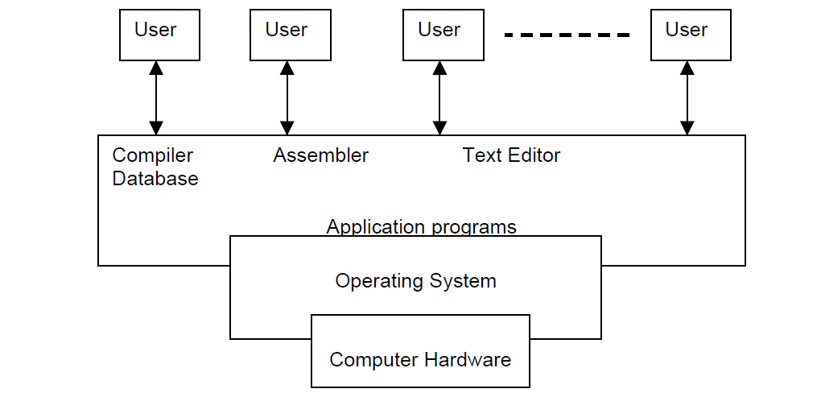
Basic view of a Computer System

Slide 9
Operating System is a resource allocator
A computer system has many resources
These resources are the CPU time, memory space, files storage space, input/output devices and so on.
The Operating System acts as a manager of all of these resources and allocates them to the specific programs and users as needed by their tasks.
Proper Allocation of resources

Slide 10
Cont…
An Operating System can also be viewed as a control program
control the various I/O devices and the users programs.
execution of the user programs to prevent errors and improper use of the computer resources.
The common functions of controlling and allocation of resources between different users and application programs is brought together into one piece of software called operating system.

Slide 11
Goals of OS
The main goals of the Operating System are:
To make the computer system convenient to use,
To make the use of computer hardware in efficient way/ efficient operation of the computer system .

Slide 12
Operating system objectives (Stallings)
Convenience
Efficiency
Ability to evolve

Slide 13
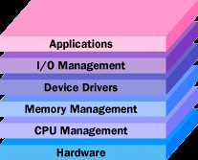
OS Functions (Stallings)

Slide 14
Early Evolution
1945: ENIAC, Moore School of Engineering, University of Pennsylvania.
1949: EDSAC and EDVAC
1949 BINAC - a successor to the ENIAC
1951: UNIVAC by Remington
1952: IBM 701
1956: The interrupt
1954-1957: FORTRAN was developed

Slide 15
Operating Systems by the late 1950s
By the late 1950s Operating systems were well improved and started supporting following usages :
It was able to Single stream batch processing
It could use Common, standardized, input/output routines for device access
Program transition capabilities to reduce the overhead of starting a new job was added
Error recovery to clean up after a job terminated abnormally was added.
Job control languages that allowed users to specify the job definition and resource requirements were made possible

Slide 16
Operating Systems In 1960s
1961: The dawn of minicomputers
1962 Compatible Time-Sharing System (CTSS) from MIT
1963 Burroughs Master Control Program (MCP) for the B5000 system
1964: IBM System/360
1960s: Disks become mainstream
1966: Minicomputers get cheaper, more powerful, and really useful
1967-1968: The mouse
1964 and onward: Multics
1969: The UNIX Time-Sharing System from Bell Telephone Laboratories

Slide 17
Supported OS Features by 1970s
Multi User and Multi tasking was introduced.
Dynamic address translation hardware and Virtual machines came into picture.
Modular architectures came into existence.
Personal, interactive systems came into existence.

Slide 18
Accomplishments after 1970
1971: Intel announces the microprocessor
1972: IBM comes out with VM: the Virtual Machine Operating System
1973: UNIX 4th Edition is published
1973: Ethernet
1974 The Personal Computer Age begins
1974: Gates and Allen wrote BASIC for the Altair
1976: Apple II
August 12, 1981: IBM introduces the IBM PC
1983 Microsoft begins work on MS-Windows
1984 Apple Macintosh comes out
1990 Microsoft Windows 3.0 comes out
1991 GNU/Linux
1992 The first Windows virus comes out
1993 Windows NT
2007: iOS
2008: Android OS
External links to page 13

Slide 19
Terms
Multicore processor
A multi-core processor is an integrated circuit to which two or more processors have been attached for enhanced performance, reduced power consumption, and more efficient simultaneous processing of multiple tasks.
A multi-core processor is a single computing component with two or more independent actual processing units (called "cores"), which are the units that read and execute program instructions.

Slide 20
OS Services
The range and extent of services provided by an Operating System depends on a number of factors.
The target environment that the Operating System is intended to support.
It is largely determined by user- visible functions of an operating system.

Slide 21
OS Services Cont..
An Operating System provides services to both the users and to the programs:
Providing environment to the programs for their execution
Users can execute their programs in an efficient way
For eg: Program execution, I/O operations, File System manipulation, Communication, Error Detection, Resource Allocation, Protection

Slide 22
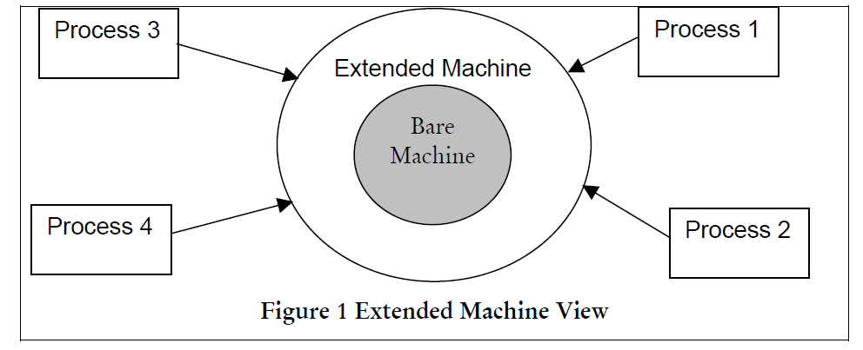
System Call
Operating System extended view

Slide 23
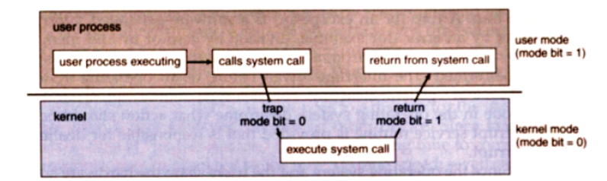
System Call (Please refer to this link: http://faculty.salina.k-state.edu/tim/ossg/Introduction/sys_calls.html)

Slide 24
System Call Cont..
Application developers often do not have direct access to the system calls, but can access them through an application programming interface (API).
The functions that are included in the API invoke the actual system calls.
By using the API, certain benefits can be gained:
Portability: as long a system supports an API, any program using that API can compile and run.
Ease of Use: using the API can be significantly easier than using the actual system call.
(Please refer to this link: http://faculty.salina.k-state.edu/tim/ossg/Introduction/sys_calls.html)

Slide 25
System Call Parameters
(Please refer to this link: http://faculty.salina.k-state.edu/tim/ossg/Introduction/sys_calls.html)

Slide 26
Types of System Calls

